Slide 1
Open and Distance Learning as a Tool for Inclusive Higher Education in Sri Lanka: Opportunities and Challenges
M.A.R.P. Rikasa
Department of Philosophy, University of Kelaniya, Sri Lanka

Slide 2
Introduction and Background
Higher education is a fundamental driver of social inclusion, economic development, and lifelong learning.
Open and Distance Learning (ODL) has become a key strategy for expanding educational opportunities.
Following the COVID-19 pandemic, Sri Lankan universities increasingly integrated digital learning into teaching and learning.
ODL enables learning beyond geographical and time constraints, offering opportunities for students from diverse backgrounds.

Slide 3
Research Problem & Objectives
Research Problem
Although ODL expands access to higher education, its contribution to inclusive education remains uncertain.
Research Gap
Previous research → online learning and technology adoption
Limited attention to ODL + inclusive higher education
Limited focus on both students and lecturers
Need to understand opportunities and challenges

Slide 4
Main Objective
To explore the role of ODL as a tool for promoting inclusive higher education in Sri Lanka.
Specific Areas
Explore the opportunities of ODL for inclusive higher education.
Identify the challenges experienced by students and lecturers.
Recommend strategies for improving inclusive digital learning

Slide 5
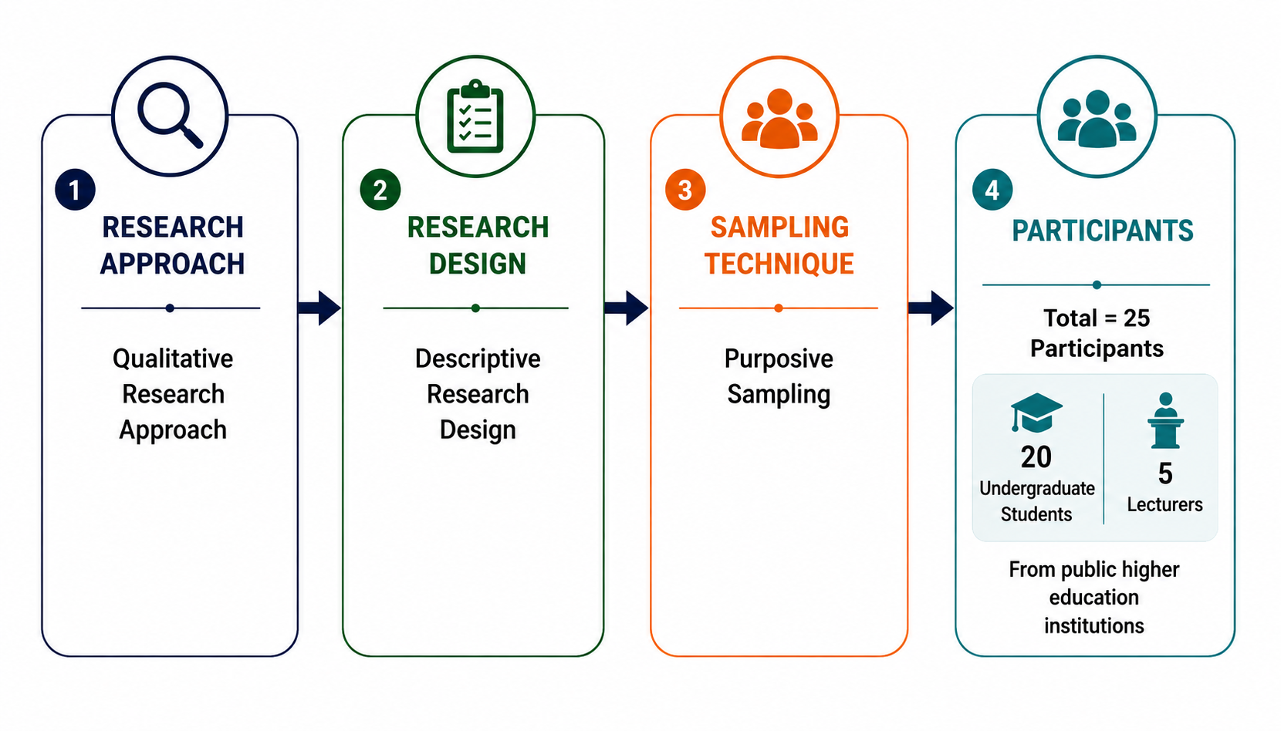
Research Methodology

Slide 6
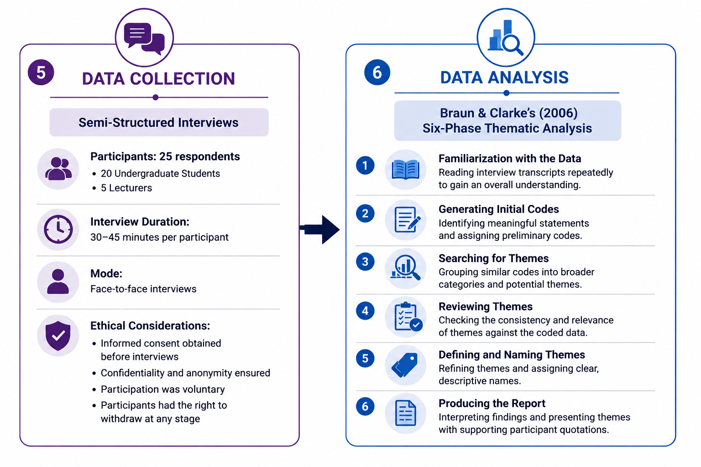
Data Collection and Analysis

Slide 7
Findings: Opportunities
1. Flexible Learning
Time and location flexibility
Supports students with personal commitments
2. Enhanced Digital Skills
Improved technological competence
3. Greater Access to Learning Resources
Wider range of online educational materials

Slide 8
Findings: Challenges
1. Poor Internet Connectivity
Interrupted learning
Missed lectures
2. Reduced Learner Engagement
Passive participation
Difficulty maintaining interaction
3. Limited Institutional Support
Technical infrastructure
Training and support

Slide 9
Discussion
ODL expands access to higher education through flexibility and increased availability of learning resources.
However, digital inequalities such as poor connectivity and limited institutional support continue to hinder inclusive participation.
The findings suggest that technology alone cannot ensure inclusive education; meaningful inclusion requires equitable access, digital literacy, and learner-centred teaching.
Therefore, strengthening digital infrastructure and institutional support is essential to maximize the inclusive potential of ODL.

Slide 10
Recommendations
Universities
Strengthen digital infrastructure
Improve Learning Management Systems
Provide continuous technical support
Lecturers
Adopt learner-centred teaching
Increase interaction
Encourage collaborative learning
Students
Improve digital literacy
Develop self-directed learning skills

Slide 11
Conclusion
Open and Distance Learning (ODL) has significant potential to promote inclusive higher education by improving flexibility, accessibility, and learning opportunities.
However, challenges such as digital inequality, limited institutional support, and reduced learner engagement continue to affect meaningful participation.
The success of ODL depends on strengthening digital infrastructure, enhancing digital literacy, and adopting learner-centred teaching practices.
Ultimately, inclusive higher education requires not only access to technology but also equitable opportunities for all students to participate, engage, and succeed.
"Technology can expand access to education, but only equitable access, meaningful participation, and strong institutional support can achieve truly inclusive higher education."

Slide 12
Thank you for your attention.

